Slide 1


Python Basics
PYTHON IN FINANCE

Slide 2

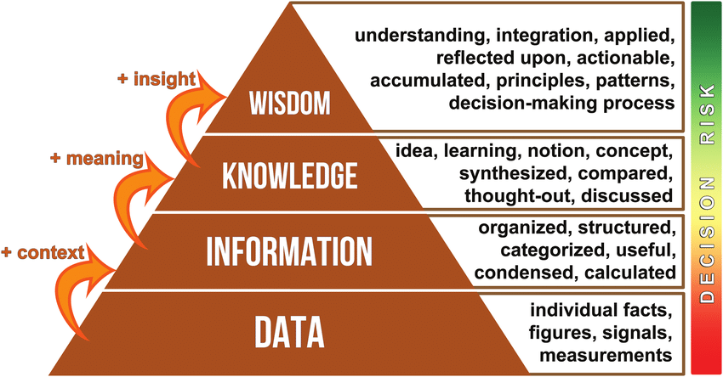
Data
DIGITAL PIONEERS
READINGS
https://searchdatamanagement.techtarget.com/definition/data
https://www.youtube.com/watch?v=sIjSY05JE9Q

Slide 3
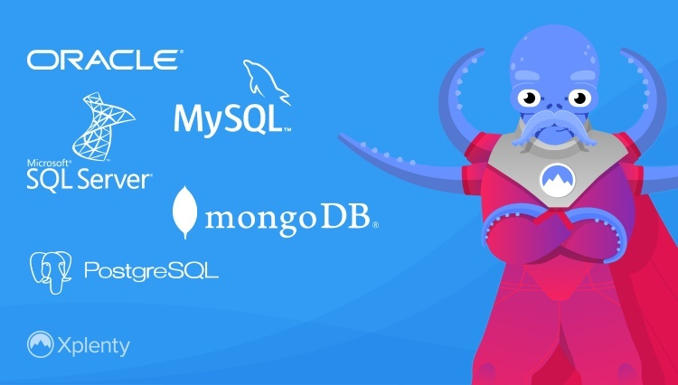
Database
DIGITAL PIONEERS
Relational Database
  mySQL
  Oracle
  MSSQL
NoSQL – non-relational
  MongoDB
READINGS
https://www.youtube.com/watch?v=ZS_kXvOeQ5Y
https://www.youtube.com/watch?v=4qFZ-5i4GS8

Slide 4
Big data & Data lake
DIGITAL PIONEERS
What is Data?
The quantities, characters, or symbols on which operations are performed by a computer, which may be stored and transmitted in the form of electrical signals and recorded on magnetic, optical, or mechanical recording media.
What is Big Data?
Big Data is also data but with a huge size. Big Data is a term used to describe a collection of data that is huge in volume and yet growing exponentially with time. In short such data is so large and complex that none of the traditional data management tools are able to store it or process it efficiently.
READINGS
https://www.youtube.com/watch?v=ZS_kXvOeQ5Y
https://www.youtube.com/watch?v=4qFZ-5i4GS8

